Slide 1
Server Level Options

Slide 2

About the Author
Created By: | Sucharita Das (241163) & Rajalaxmi (301159)
Credential Information: | 8+ years of SQL Server developer/architect experience
Version and Date: | SS2008/0611/1.0
Cognizant Certified Official Curriculum

Slide 3









Icons Used
Hands on Exercise
Questions
Tools
Coding Standards
Test Your Understanding
Reference
A Welcome Break
Contacts
Demonstration

Slide 4
Objective
Server wide configuration options

Slide 5
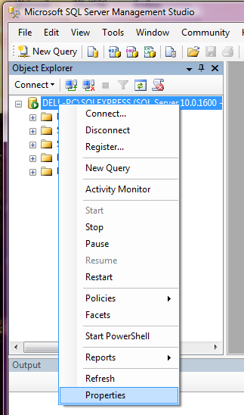

Slide 6
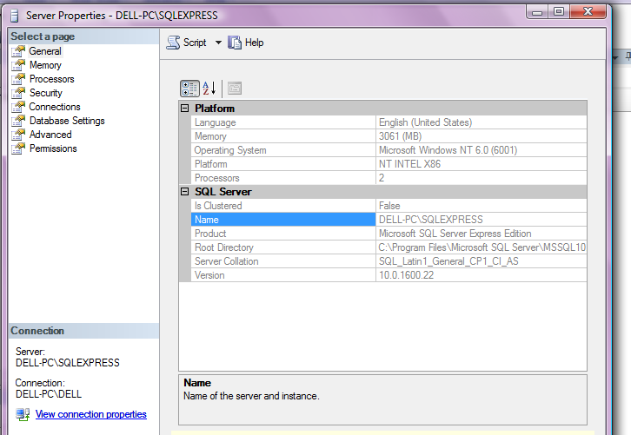
General
High availability feature

Slide 7
General
A set of rules that determine how data is sorted and compared
Notes:
A collation specifies the bit patterns that represent each character and the rules by which characters are sorted and compared.

Slide 8
Collation Properties
The code page for non-Unicode characters
The sort order to be used for non-Unicode characters
The sort order to be used for Unicode characters

Slide 9
Code page
Defines the characters mapped to bit patterns
Includes:
Uppercase and lowercase characters
Digits
Symbols and special characters [(!),(@),(#),(%)]
Types:
Single-byte code pages
Double-byte code pages

Slide 10
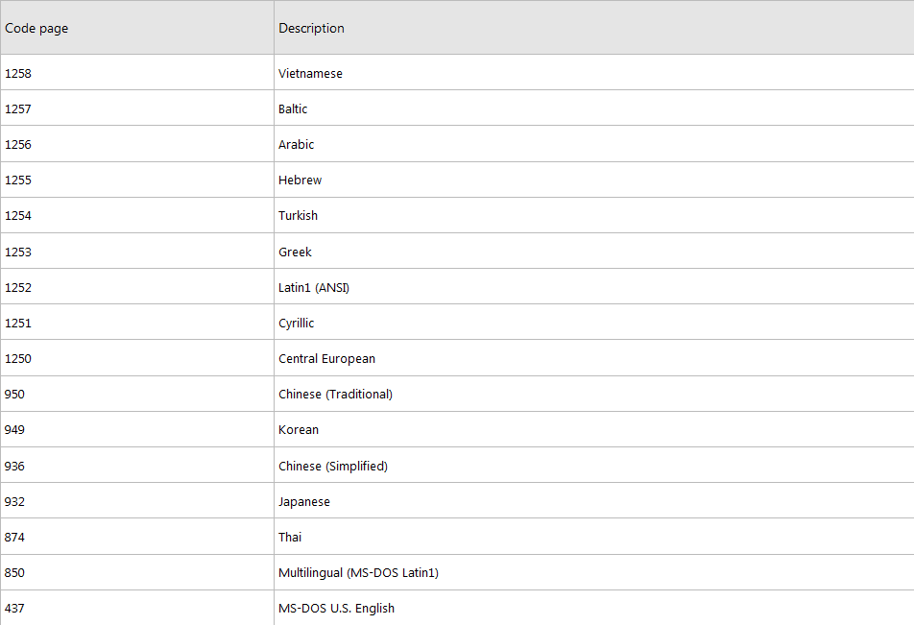
Code pages supported by SQL Server

Slide 11
Sort order
Determines how characters compare and assign their values
Called as Collating Sequence

Slide 12

Sort order (suffix) | Description
Case-sensitive (_CS) | Distinguishes between uppercase and lowercase letters
Case-insensitive (_CI) | Considers the uppercase and lowercase letters to be identical for sorting purposes
Accent-sensitive (_AS) | Distinguishes between accented and unaccented characters. For example, 'a' is not equal to 'ấ'
Accent-insensitive (_AI) | Considers the accented and unaccented versions of letters to be identical for sorting purposes
Kana-sensitive (_KS) | Distinguishes between the two types of Japanese kana characters: hiragana and katakana
Width-sensitive (_WS) | Distinguishes between a single-byte character and the same character when represented as a double-byte character
Notes:
Case sensitive: If selected, lowercase letters sort ahead of their uppercase versions. Hiragana: curving style, native japanese words. Katakana: angular characters, japanese words which originated from english.

Slide 13
Collation Name
SQL_Latin1_General_CP1_CI_AS
SQL Collation
Unicode sort: Dictionary order
Code page 1252
Case Insensitive
Accent Sensitive

Slide 14
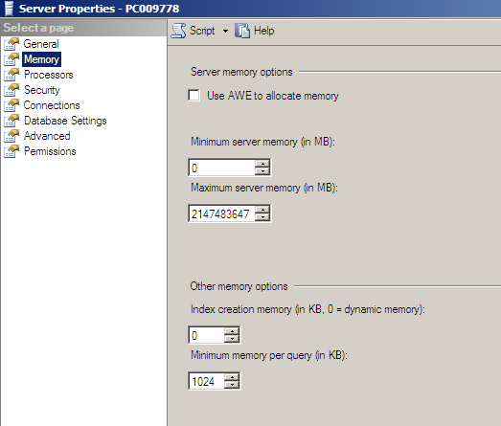
Memory
Address Windowing Extensions
Maximum amount of memory initially allocated for creating indexes
Notes:
Maximum server memory must be less than the amount of physical memory present in the system.
sp_configure

Slide 15
Enabling AWE
If free memory < 3 GB
Dynamic memory allocation (non-AWE mode)
If max server memory is set and
free memory >= 3 GB
Instance acquires the max server memory
free memory < max server memory
Instance acquires all of the available memory
Notes:
Supports very large memory sizes

Slide 16
Multiple Instances
Each instance has a max server memory setting
Sum of the max server memory values for all the instances < amount of physical memory in the computer

Slide 17
Minimum memory per query
Allows to specify a minimum amount of memory (in KB)
Relevant for operations like:
Sort
Merge
Hash
Notes:
Sort,merge,hash operations receive memory in a very dynamic fashion. If you need to do a lot of such operations, improve performance by adjusting this value. On smaller machines, setting this value too high causes virtual memory to page, this degrades server performance.

Slide 18
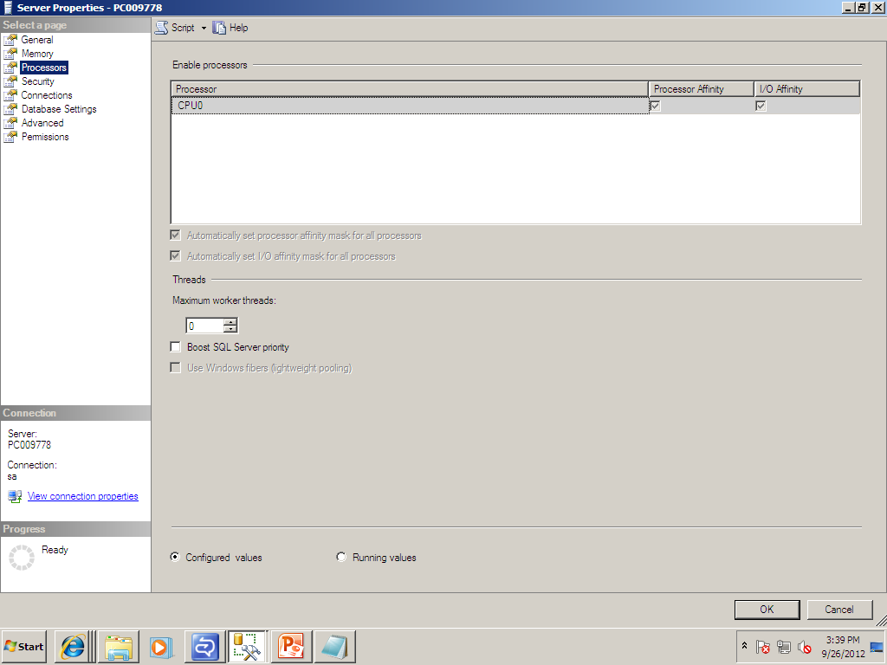
Processors

Slide 19
Max worker threads
For each query request, a separate operating system thread is created
Thread pooling helps optimize performance when large numbers of clients are connected to the server
Enables SQL Server to create a pool of worker threads to service a larger number of query request, which improves performance
Default value 0 - allows SQL Server to automatically configure the number of worker threads at startup
Notes:
However, with hundreds of connections to the server, using one thread per query request can consume large amounts of system resources. When the actual number of query request is less than the amount set in max worker threads, one thread handles each query request. However, if the actual number of query request exceeds the amount set in max worker threads, SQL Server pools the worker threads so that the next available worker thread can handle the request.

Slide 20
Priority boost
Specify whether Microsoft SQL Server should run at a higher scheduling priority than other processes on the same computer
Default 0 - Normal priority
If Enabled - Higher priority
Raising the priority too high may drain resources from other essential processes
Notes:
If the machine is fully dedicated to SQL Server, enable the priority boost. It is recommended to leave it alone.

Slide 21
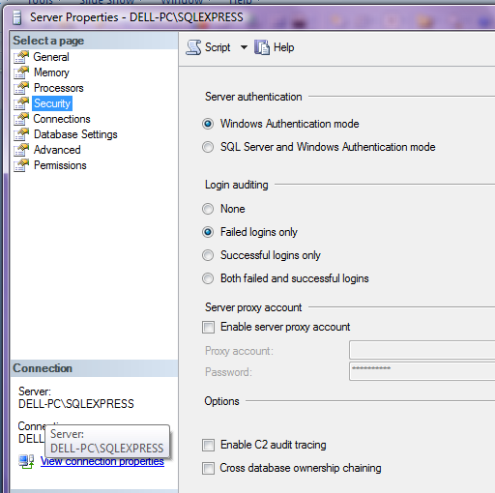
Security
Specify authentication mode
Record attempted user accesses and other SQL Server log information

Slide 22
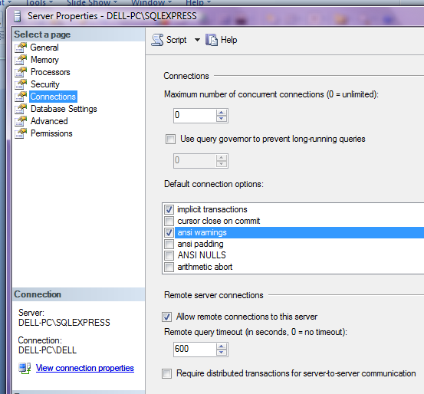
Connections
Maximum concurrent user connections
Allow other instances to connect remotely to this server
Notes:
Maximum concurrent user connections
Specify the maximum concurrent user connections. Entering zero means there can be an unlimited number of concurrent user connections.
Query time-out (seconds)
Specify the number of seconds that must elapse during a remote query before the query times out. Specifying zero means that an unlimited amount of time can elapse.

Slide 23
Query Governor
Prevents long-running queries
Does not execute queries
Time taken to run > query governor cost limit

Slide 24
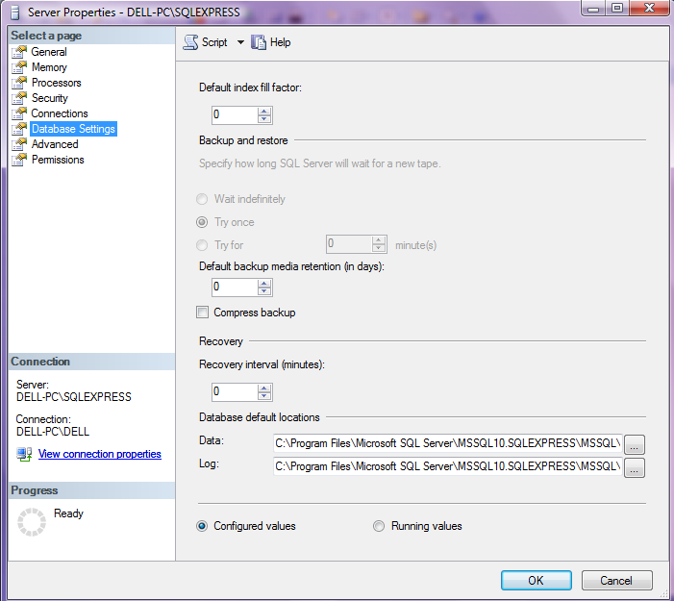
Database Settings
Percentage of space to be filled with data
Length of time to retain each backup set
Default location of data and log files
Notes:
The fill-factor option is provided for fine-tuning index data storage and performance. When an index is created or rebuilt, the fill-factor value determines the percentage of space on each leaf-level page to be filled with data, reserving the remainder on each page as free space for future growth. For example, specifying a fill-factor value of 80 means that 20 percent of each leaf-level page will be left empty, providing space for index expansion as data is added to the underlying table. The empty space is reserved between the index rows rather than at the end of the index.
The fill-factor value is a percentage from 1 to 100, and the server-wide default is 0 which means that the leaf-level pages are filled to capacity.
The media retention option helps protect backups from being overwritten until the specified number of days has elapsed.

Slide 25
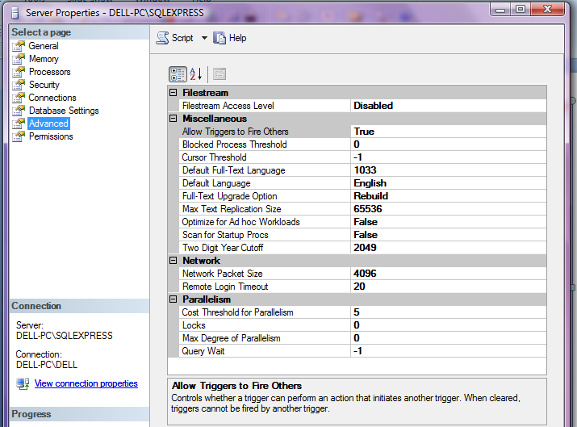
Advanced
Threshold at which SQL Server creates and runs parallel plans for queries
Notes:
Use the blocked process threshold option to specify the threshold, in seconds, at which blocked process reports are generated.
If the query optimizer estimates that the number of returned rows is greater than this threshold, the cursor is generated asynchronously, allowing the user to fetch rows from the cursor while the cursor continues to be populated. Otherwise, the cursor is generated synchronously, and the query waits until all rows are returned.
If you set cursor threshold to -1, all keysets are generated synchronously, which benefits small cursor sets. If you set cursor threshold to 0, all cursor keysets are generated asynchronously. With other values, the query optimizer compares the number of expected rows in the cursor set and builds the keyset asynchronously if it exceeds the number set in cursor threshold. Do not set cursor threshold too low, because small result sets are better built synchronously.
Use the max text repl size option to specify the maximum size (in bytes) of text, ntext, varchar(max), nvarchar(max), varbinary(max), xml, and image data that can be added to a replicated column
A two-digit year that is less than or equal to the last two digits of the cutoff year is in the same century as the cutoff year. A two-digit year that is greater than the last two digits of the cutoff year is in the century that precedes the cutoff year. For example, if two digit year cutoff is 2049 (the default), the two-digit year 49 is interpreted as 2049 and the two-digit year 50 is interpreted as 1950.
Optimize Ad hoc Workloads:
At a very high level, the SQL Query Optimizer takes in a batch for execution and tries to locate an appropriate query plan in the plan cache. If it’s unable to find one, it compiles a plan and stores it in cache so that the next time it’s called, the cost of compiling such a plan is not incurred. The downside to this is that if the batch (and hence the plan) is only used once, that plan will take up space in memory that could be better allocated towards something else.
When “Optimize for Ad hoc Workloads” is enabled, an extra step is added to the above process. The first time a plan is created for a batch, it isn’t stored in the cache. Instead, a hash of the plan is stored, which takes up much less space. If a plan is used that already has a hash stored, then the full plan is added to the cache since it has now been used twice and is likely to be called again in the future.

Slide 26
Advanced
Limit the number of processors to use in parallel plan execution
Notes:
Setting maximum degree of parallelism to 0 allows SQL Server to use all the available processors up to 64 processors. To suppress parallel plan generation, set max degree of parallelism to 1. Set the value to a number greater than 1 to restrict the maximum number of processors used by a single query execution.

Slide 27
Questions

Slide 28
Summary
Configuration changes can degrade system performance just as easily as they can improve it

Slide 29
References
Kalen Delaney, “Inside Microsoft SQL Server 2000”, 2001
http://msdn.microsoft.com/en-us/library/aa215238%28v=sql.80%29.aspx
http://sqlserverpedia.com/blog/sql-server-bloggers/optimizing-for-ad-hoc-workloads/
http://www.databasejournal.com/features/mssql/article.php/3302341/SQL-Server-and-Collation.htm

